Slide 1

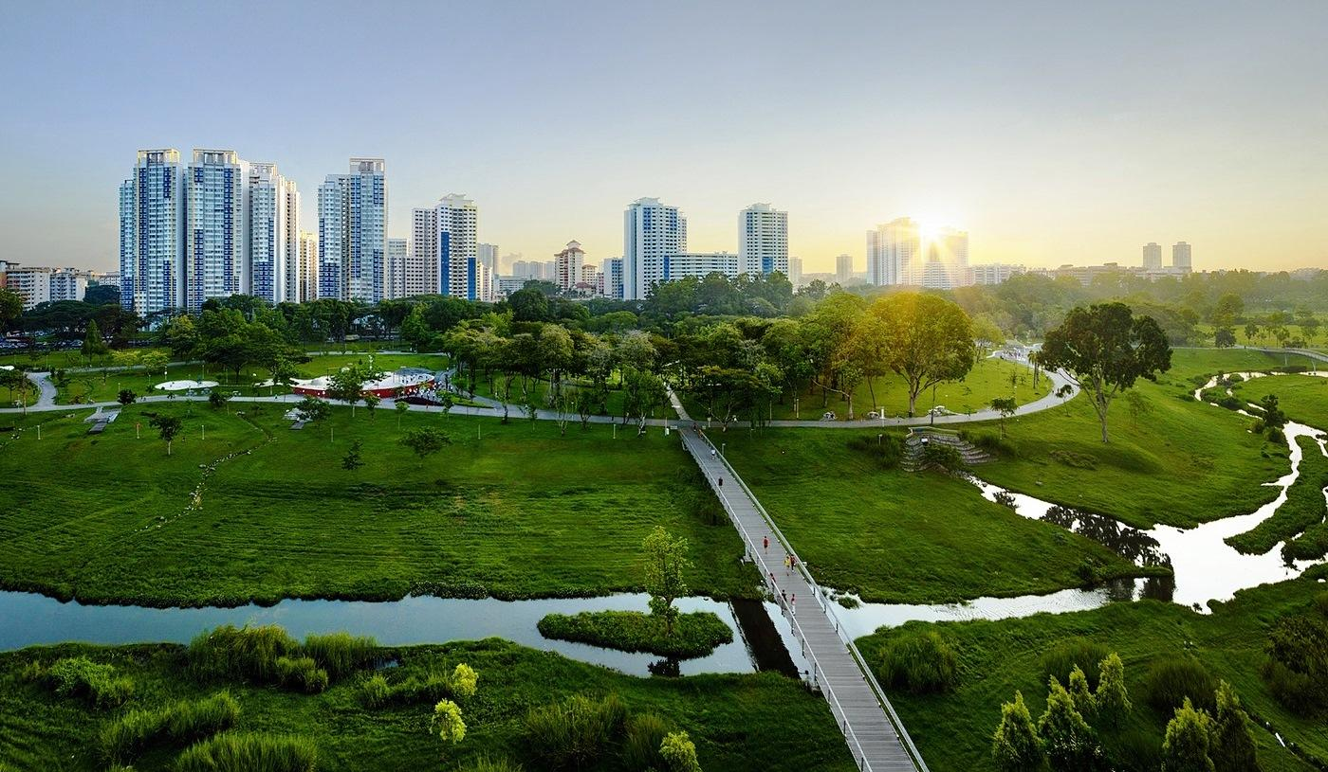
Team: Shingles All The Way Team Members:
Pulkit Varshney (114709284)
Pratik Thorwe (113221363)
Saurabh Parekh (114356444)
Purva Makarand Mhasakar (114354303)

Slide 2




Goals
Goals
REDUCE THE ADVERSE PER CAPITA ENVIRONMENTAL IMPACT OF CITIES
IMPLEMENT POLICIES FOR RESOURCE EFFICIENCY AND DISASTER RISK REDUCTION
ENHANCE INCLUSIVE AND SUSTAINABLE URBANIZATION
SUPPORT LEAST DEVELOPED COUNTRIES IN SUSTAINABLE & RESILIENT DEVELOPMENT

Slide 3
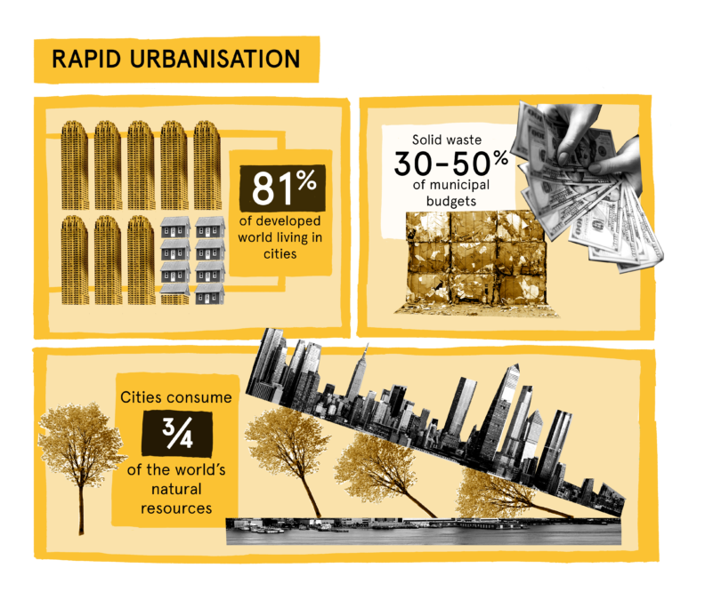
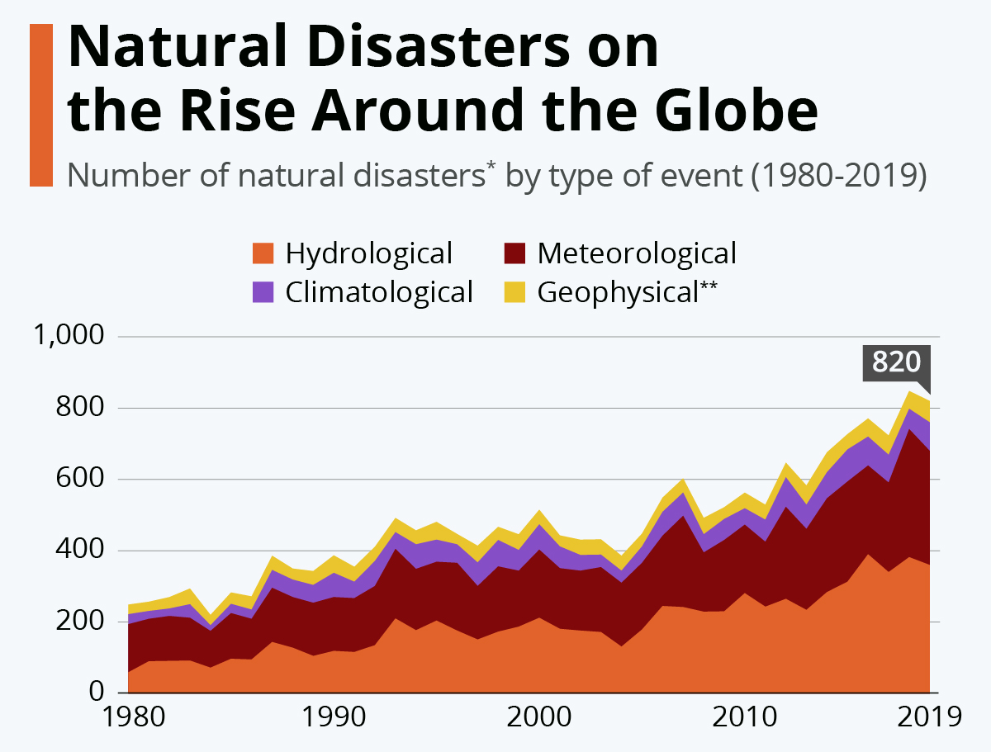
3.9 billion people live in cities globally. 5 billion people will live in cities by 2030.
Cities occupy 3 percent per cent of the Earth's land. Yet they still account for 60–80 percent of energy consumption and 75 percent of carbon emissions.
By 2050, about 70% of the world’s population is expected to live in urban areas.
Why do we care?
Sustainable development is a proven catalyst for innovation.
- Anne M. Mulcahy

Slide 4
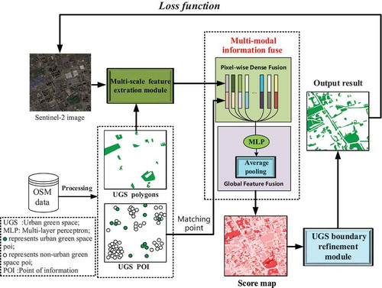
Background
156 countries have implemented National Urban Policies and only half are in implementation Stage.
Urban Policies
Convenient Access
Only half of the urban population have access to public transportation.
500m walking distance from buses.
1000m from Railway or Ferry
Slum Dwellers
The Majority of more than 1 Billion Slum Dwellers reside in 3 regions:
Eastern and South Eastern-Asia (370M)
Sub-Saharan Africa (238M)
Central and Southern Asia (226M)

Slide 5
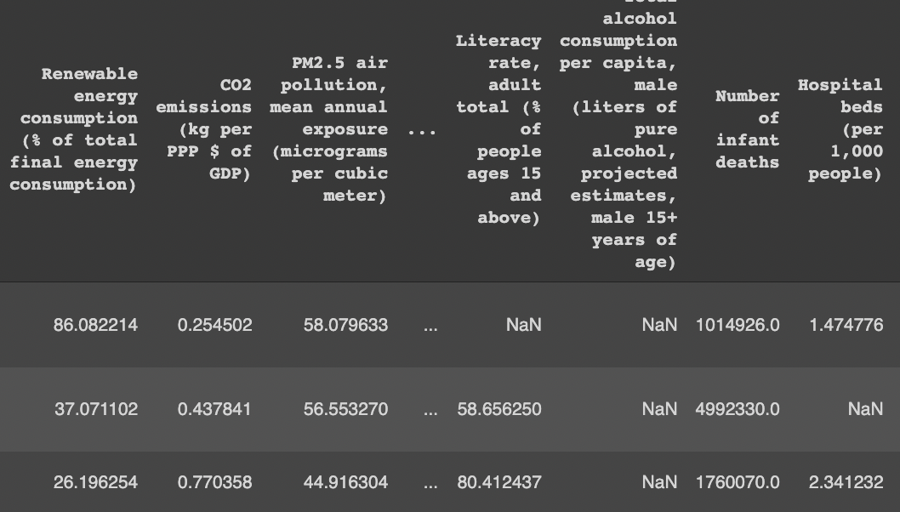
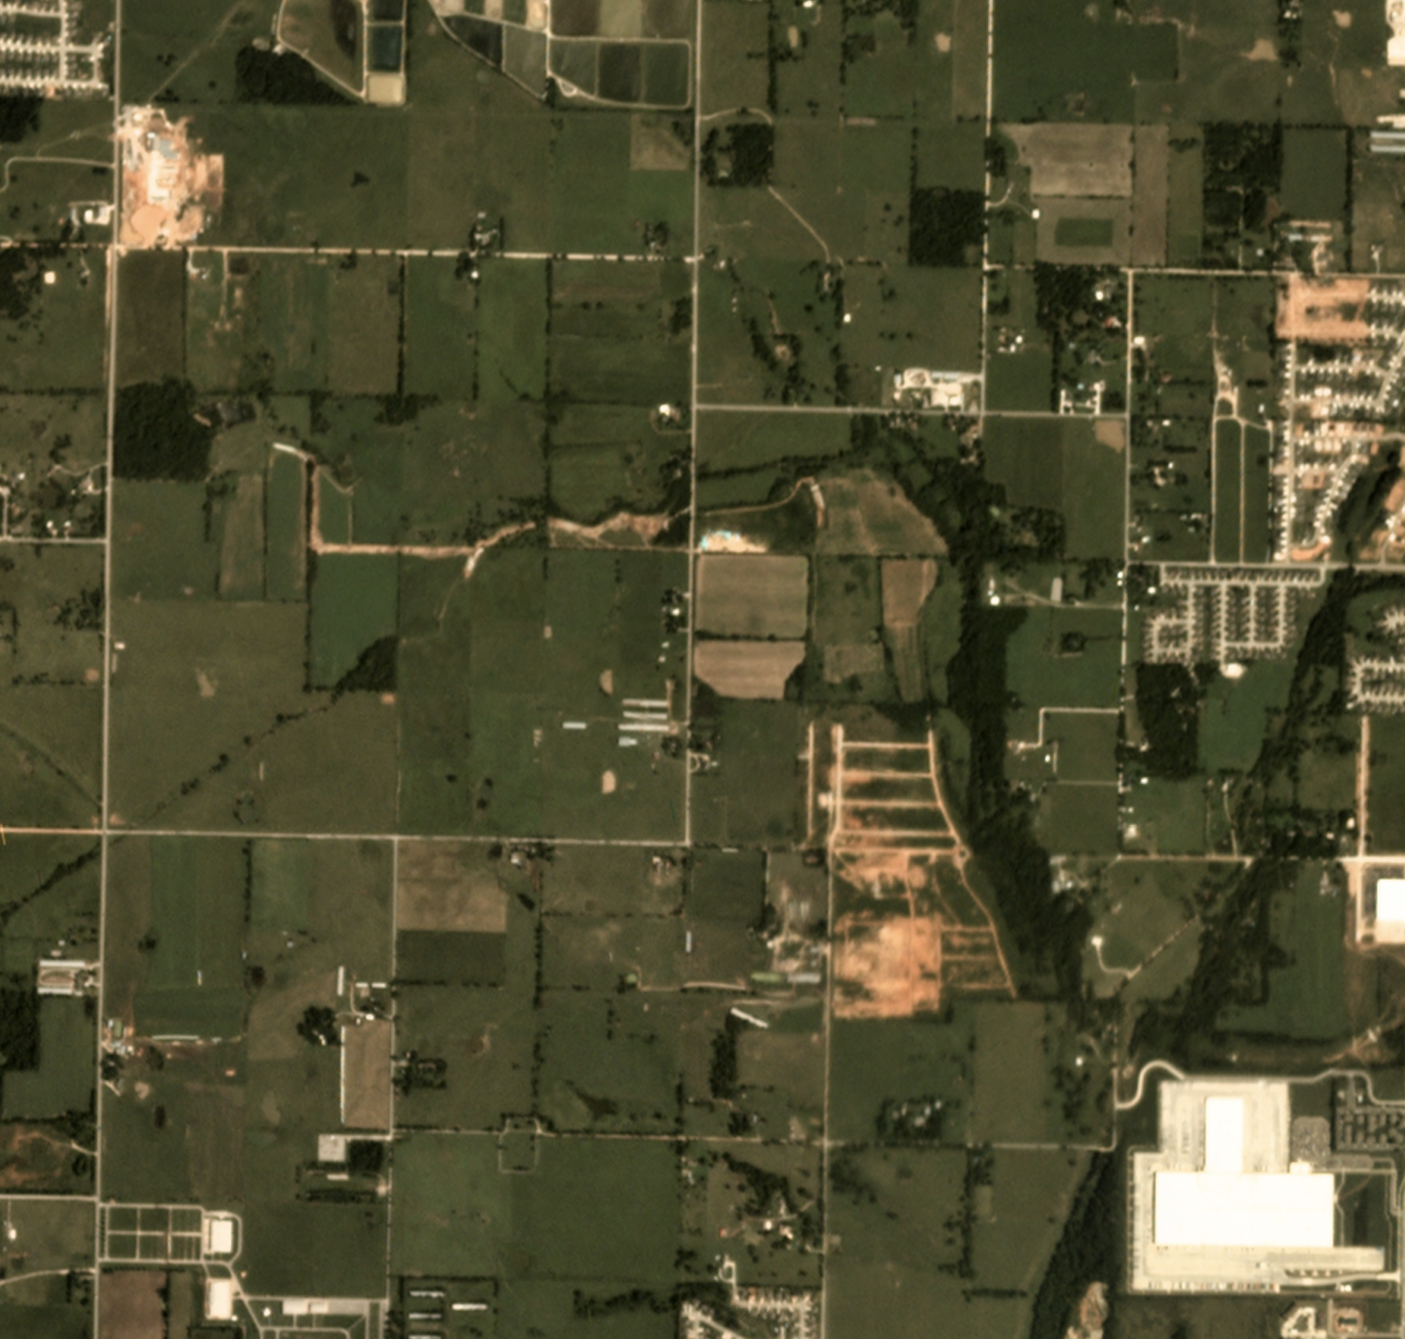
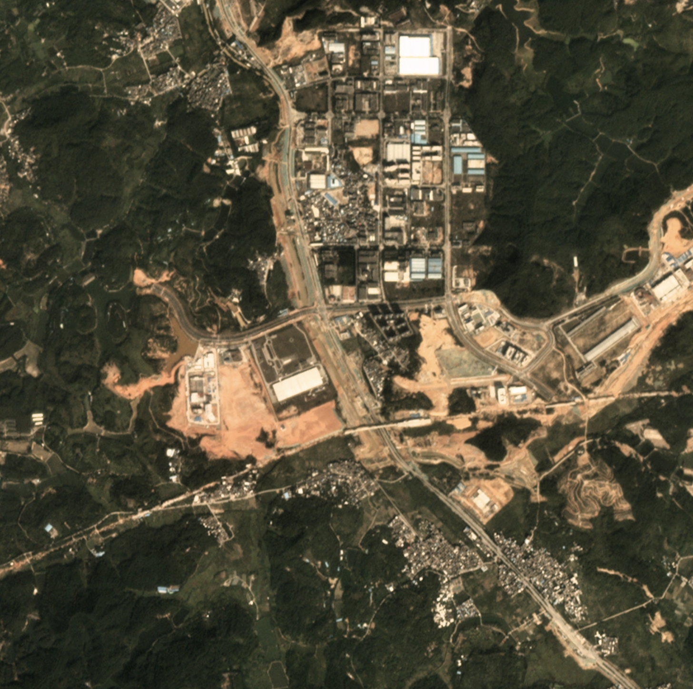
About Dataset
Source: World Bank
Data Format: table in a csv file
Number of Countries: 266
Number of Features/Indicators per Country: 1443
Number of Years: 51 (1960 - 2020)
Source: SpaceNet
Data Format: images in tiff files, consists of 60 worldwide major cities.
Number of areas of interest(AOI): 101
Total observed area: 41000 km²
World Development Indicators(WDI) dataset
Satellite Images dataset

Slide 6


Streaming through the data
For structured data such as csv and json
To find correlation between features for content based recommendation
For unstructured data such as Images
To identify features and obtain a structured data

Slide 7
Extracting Correlation among features
Hypothesis Testing
Claiming that the dependency of the developing countries will reduce over the period.
Testing if the hypothesis can be accepted or not.
Content Based Recommendation System
Similarity Search
Evaluate the feature responsible for sustainability over past 25 years.
Predict the changes in the required features over upcoming years.
Identify similarity between features of the countries.
Cluster the countries with respect its urban sustainability.

Slide 8
Work Flow
Streaming the data to structurise it
Provide the hypothesis and perform experiments to accept/reject it.
Dataset collection, and pre-processing
Extracting similarity among features and clustering
Providing recommendations for sustainable development

Slide 9
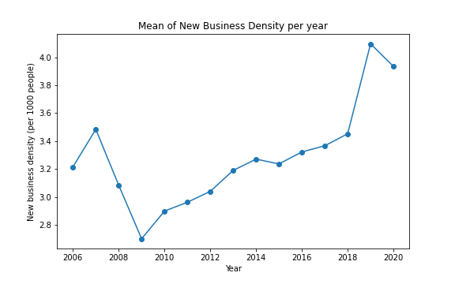
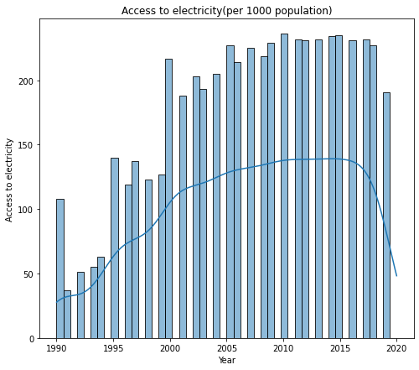
Experiments on structured data
Shortlisting
We have around 1450 World Development Indicators for each country. Shortlisted 121 features, based on SDG-11
Principal Component Analysis
Applied PCA to find the dominant features and further reduced our dataset to 35 features
Multi Dimensional Analysis
Performed MDS by using the pairwise distance as a dissimilarity matrix, and found out the highly correlated features.

Slide 10
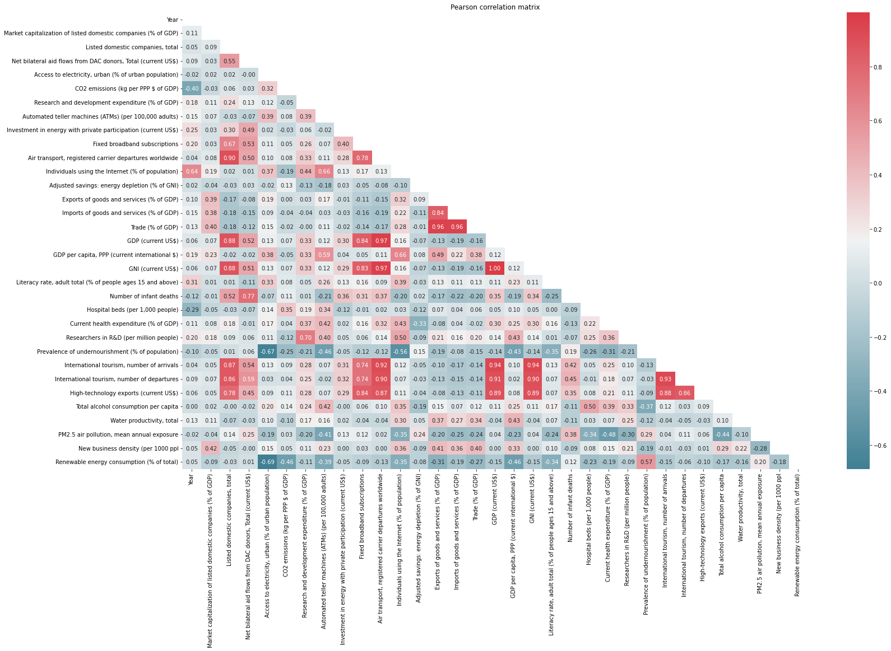
Net bilateral aid flows from DAC donors, Total (current $US)
New Business density (per 1000 people)

Slide 11
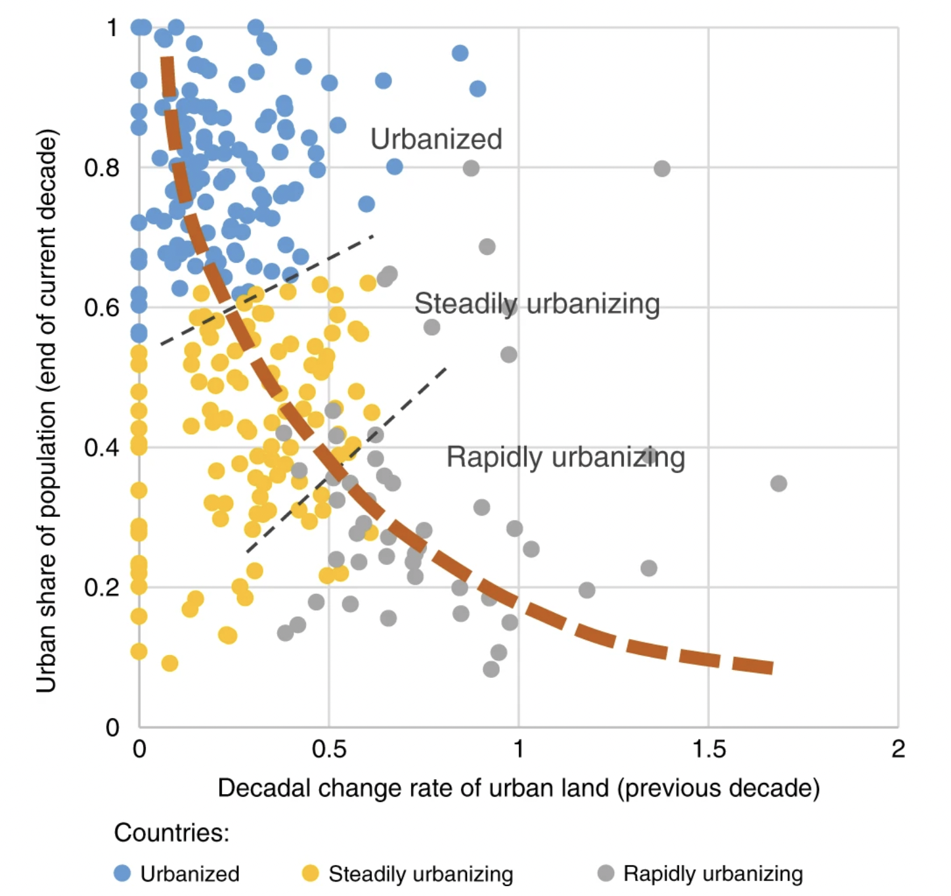
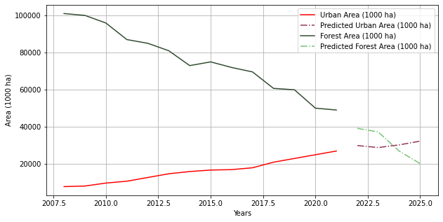
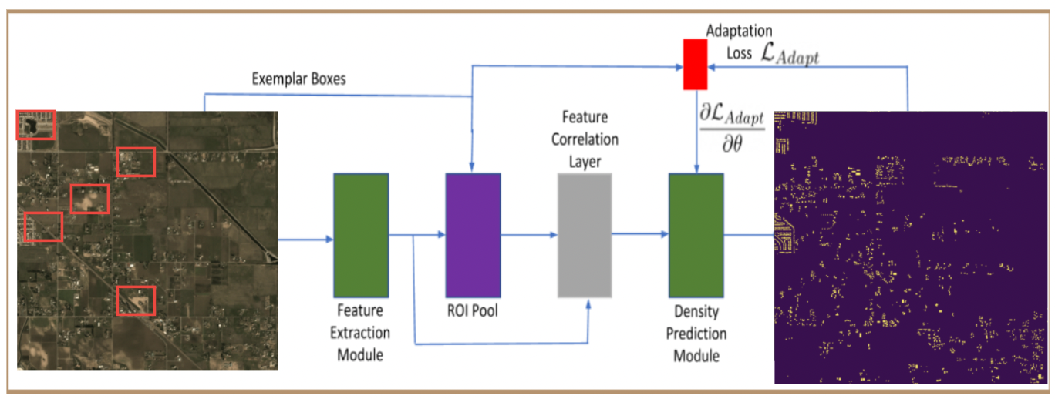
Experiments on unstructured data
Using satellite images to perform Image segmentation by UNet++ and CNN with Few-shot counting to : track urban area & forest coverage overtime by detecting building footprints & green area.
Prediction of urban area & forest area coverage
Correlation between building footprints ( from unstructured data ) & economic growth and population (from structured data) for cities.
Figure 1 : representing cluster of countries with respect to urbanization
Figure 2 : Few Shot Counting
Figure 3 Prediction of Area coverage

Slide 12
Reducing Dependency on developed countries
Impact
Creating sustainable cities across various parts of the world
Leading in Sustainable growth of the developing countries

Slide 13
Work Distribution
Data Collection: Pratik
Data Pre-processing: Saurabh
Feature Extraction: Pratik
Similarity Search: Pulkit
Clustering: Saurabh
Tensor Flow: Purva
Recommendation: Purva
Visualisation: Pulkit

Slide 14
Thank you
Shingle Bell !!
Shingle Bell !!
Shingles all the way !!

Slide 15
References
https://spacenet.ai/sn7-challenge/
https://databank.worldbank.org/source/world-development-indicators
https://sdgs.un.org/goals
https://www.tandfonline.com/doi/full/10.1080/15481603.2021.1933367
https://github.com/cvlab-stonybrook/LearningToCountEverything.
https://www.nature.com/articles/s41467-020-15788-7/figures/4
https://www.nature.com/articles/s41467-020-15788-7
https://3ng5l43rkkzc34ep72kj9as1-wpengine.netdna-ssl.com/wp-content/uploads/2019/02/sustainable-cuty-1-720x480.jpg
https://sbi.sydney.edu.au/wp-content/uploads/2020/03/sbi-megatrend-rapid-urbanisation-infographic-792x675.png
https://www.totabc.org/sdg/sustainable-cities-communities
https://cdn.statcdn.com/Infographic/images/normal/22686.jpeg

Slide 16
